Slide 1

FOOD-CYCLED
TEAM MEMBERS :
Shreyaa Sridhar
Navya Battu
Sulochana Rani Mulpuri
Harika Adivanne

Slide 2
Motivation
Application that focuses on food waste management
Concept of taking excess food (example - restaurants) and providing it to places that are in need.(example - Soup Kitchens)
We selected this project from Enactus

Slide 3
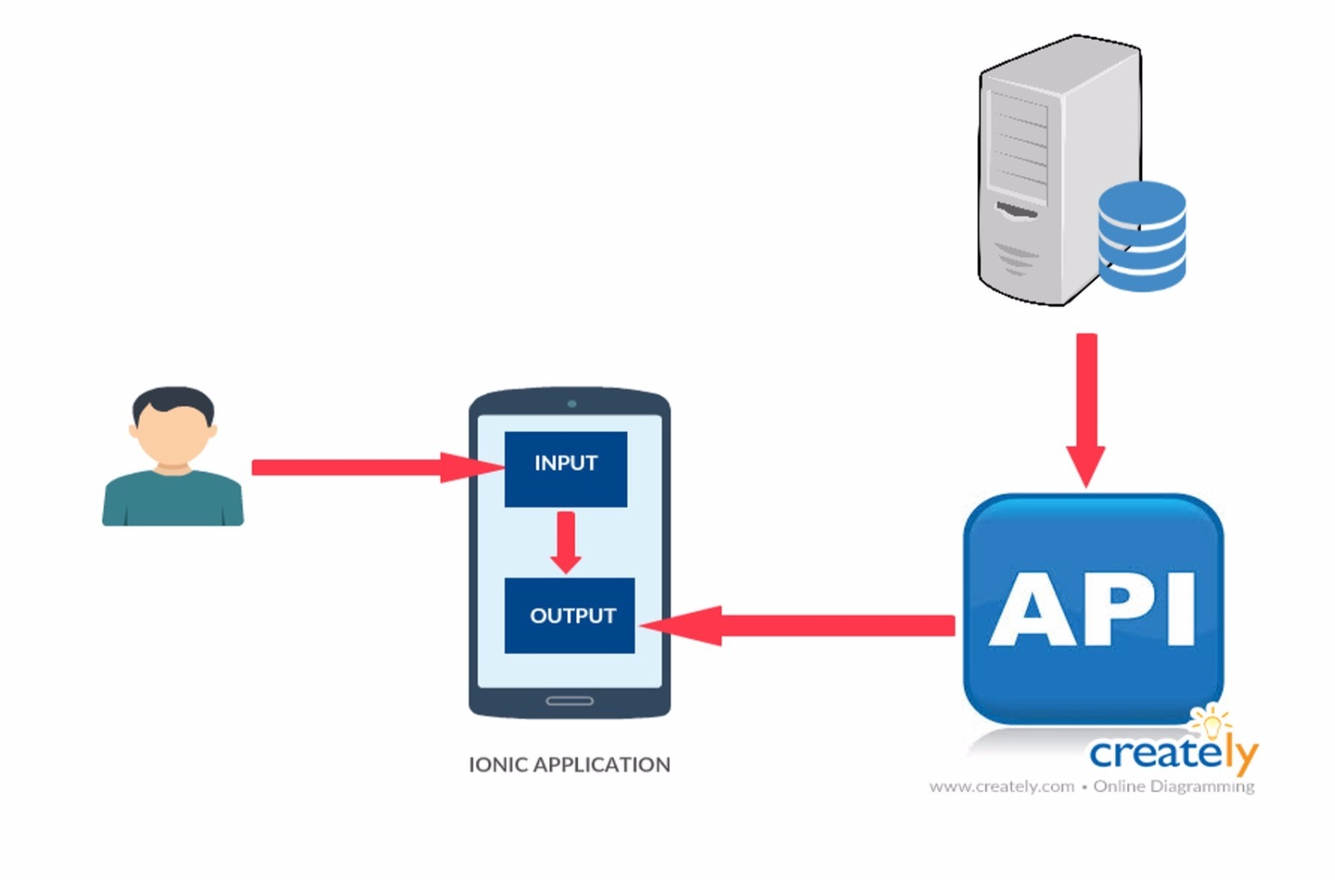
Architecture

Slide 4
Technologies Used
HTML
CSS
Ionic 3
Firebase
PostgreSQL

Slide 5
Features
Locations of the Soup Kitchens is displayed using Google Maps API
Used Edamam API to retrieve the nutrient details of a particular food.
Single Login For User and Volunteer

Slide 6
Cont..
Used Camera plugin for Uploading the food image
OAuth Login
Notifications alerts for USER and VOLUNTEER

Slide 7
DEMO

